Slide 1


VELALAR COLLEGE OF ENGINEERING AND TECHNOLOGY (AUTONOMOUS) THINDAL, ERODE-638012
DEPARTMENT OF COMPUTER SCIENCE AND ENGINEERING
Automated Classroom Attendance System Using
Deep Learning
TEAM MEMBERS :
SHAMRUTHYA GOPAL N(23CSR087)
SURIYA N (23CSR100)
RUBAN K (23CSR078)
UNDER THE GUIDANCE OF:
Dr.S.Russia B.E.(CSE), M.Tech(CSE),Ph.D.,
Professor/CSE

Slide 2
TITLE
AI-Based Automated Classroom Attendance System Using Deep Learning.
DOMAIN : Computer Vision and Deep Learning

Slide 3
ABSTRACT
Attendance monitoring in educational institutions is traditionally a manual and time-consuming process, often prone to human errors and proxy attendance. This project proposes an Automated Classroom Attendance System using Deep Learning integrated with a smart notification mechanism.
Future enhancements include the development of a cloud-based dashboard, mobile application integration, and student attention/liveliness analysis.

Slide 4
SCOPE AND OBJECTIVE
Scope and Objective :
Works in any classroom with a camera setup.
Can be integrated with existing school databases.
Scalable to multiple classrooms and departments.
Future enhancements: Cloud-based dashboard, Mobile app, Attention monitoring, AI-based analytics.
To automate the student attendance process using AI and face recognition.
To reduce classroom time spent in manual roll-call.
To eliminate proxy attendance and human error.
To auto-send attendance reports to faculty and departments.

Slide 5
EXISTING SYSTEM (Technologies and Techniques)
Problems in Current Manual Attendance System
Time-consuming (5–10 minutes per class).
Proxy attendance (friends answering for absentees).
Errors in marking/recording.
No immediate reporting to parents or staff.
No digital records.
Existing Automated Systems (Based on Journal Paper)
Technology Used:
CCTV cameras in classroom
Face detection using Dlib MMOD
Face recognition using ResNet-29 with Triplet Loss
Limitations of Existing System:
No real-time alert before capturing images.
No SMS/WhatsApp/email notification to faculty/parents.
No options for late attendance or OD marking.
Limited to local system (no cloud or mobile app).

Slide 6
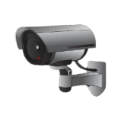
PROPOSED WORK
Student
Database
ML MODEL
INTIMATION
1.Subject faculty
2.Class advisor
3.Class mentor
4.HoD
API FLASK
Group
Photo
ATTENDANCE DATABASE

Slide 7
Hardware and software requirements
Hardware
Camera (HD/IP)
System (PC/Laptop)
Server (optional / local)
Software
Python
OpenCV
Deep Learning model (CNN)
Database (MySQL/Firebase)
OS

Slide 8
MODULES DESCRIPTION
Module 1: Student Registration & Dataset Creation
This module is used to register students by capturing multiple facial images through a camera. The collected images are labeled with student ID and stored in the student database for training the deep learning model.
Module 2: Face Detection Module
In this module, the live classroom image or group photo is processed to detect human faces using computer vision techniques. Each detected face is cropped and forwarded for recognition.
Module 3: Face Recognition Module
The detected faces are compared with the trained dataset using a deep learning (CNN) model. The system identifies students by matching facial features with stored records.
Module 4: Attendance Management Module
Once a student is recognized, attendance is automatically marked in the attendance database with date and time, eliminating manual intervention and proxy attendance.
Module 5: Notification & Reporting Module
This module sends attendance information to subject faculty, class advisor, mentor, and HOD through a smart notification mechanism. Reports can also be generated for further analysis.

Slide 9



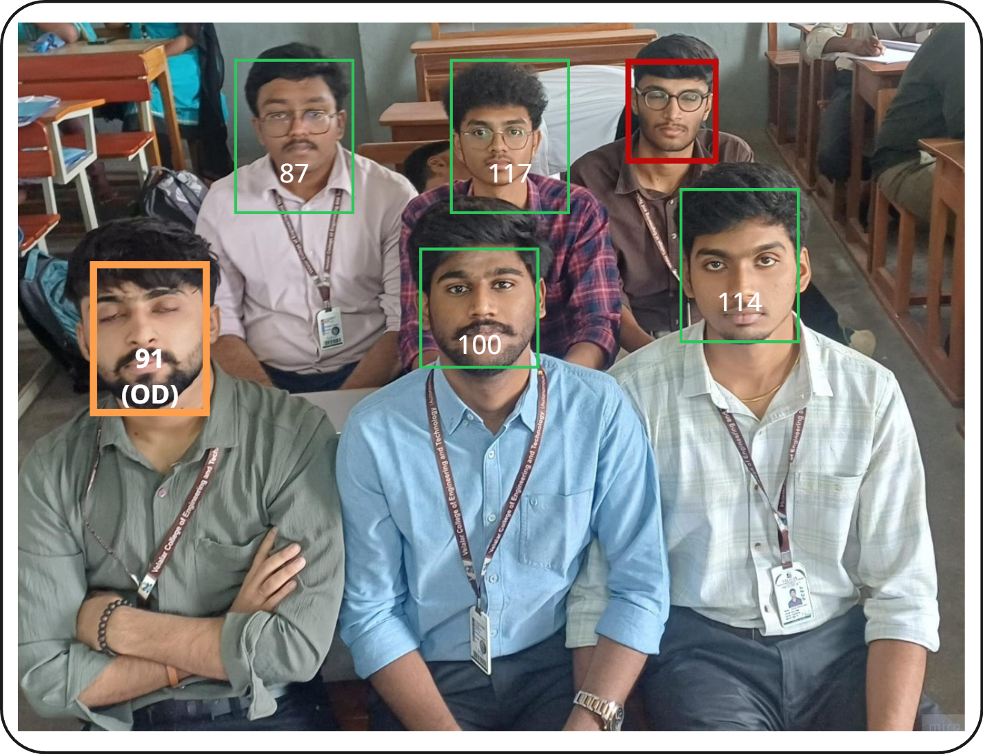


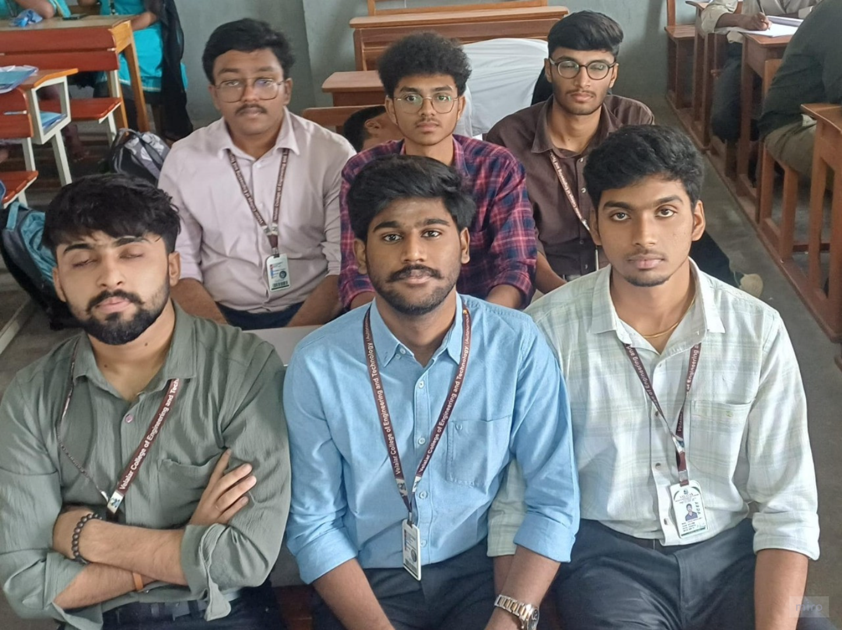
Design & Implementation Details
87 100 117
114 91
ML MODEL
STUDENT DATABASE
GROUP PHOTO

Slide 10
THANK YOU

